Slide 1
Identifying Slum Areas in Johannesburg, South Africa
Michael Ono, Neil Hamlett, Dylan Blough
GA DSI DC-10

Slide 2
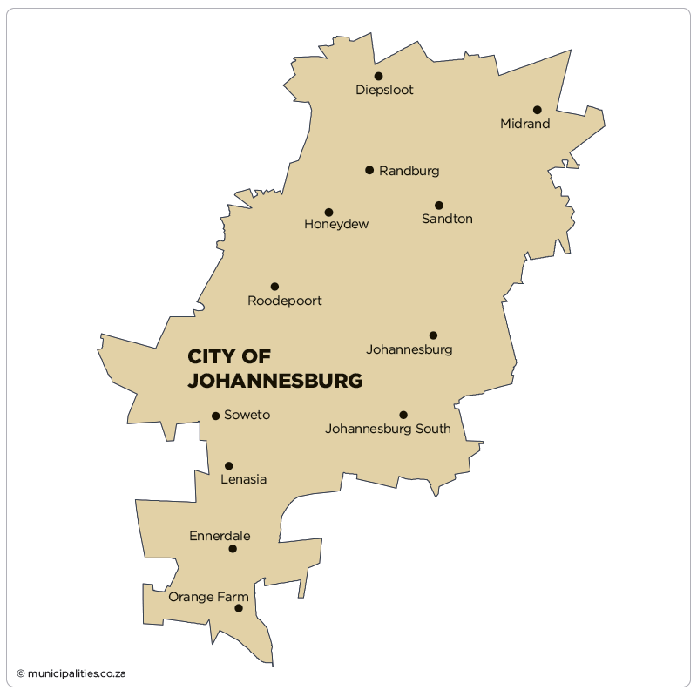
Overview of Johannesburg
Population of 4,434,827 people.
Most populous city in South Africa
40 different sub-localities within the metro area.
http://www.statssa.gov.za/?page_id=993&id=city-of-johannesburg-municipality

Slide 3
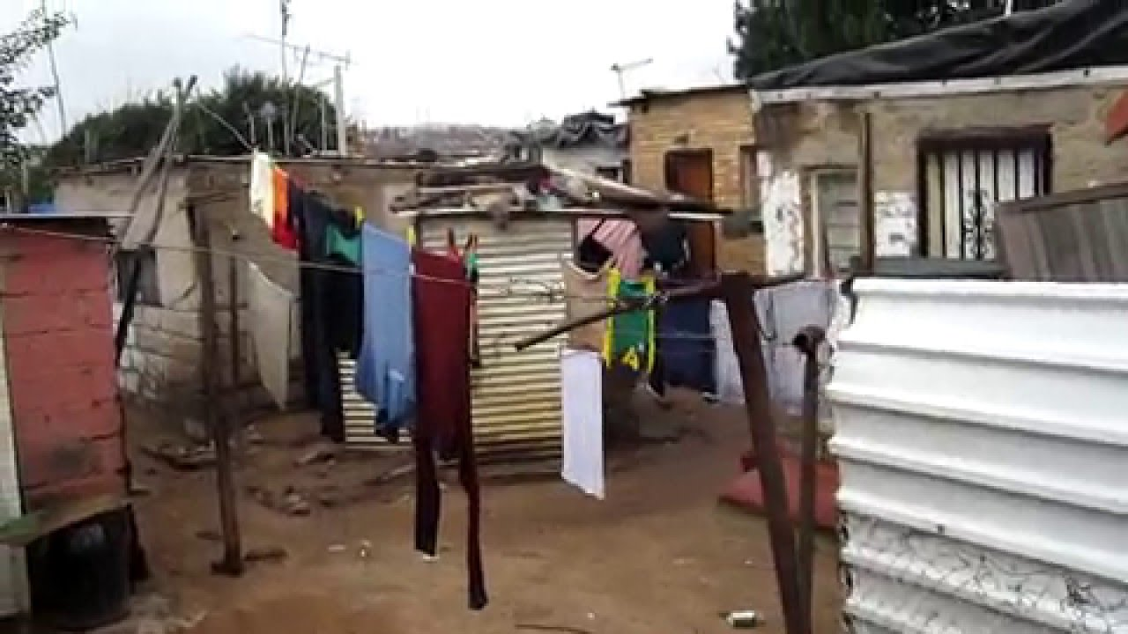
What is a slum?
Informal settlements (aka "slums") can be defined as " highly populated urban residential area consisting mostly of closely packed, decrepit housing units in a situation of deteriorated or incomplete infrastructure, inhabited primarily by impoverished persons"
For the purposes of our project, informal settlements are urban residential concentrations that are not supported by public services. Beyond infrastructure services (plumbing, electricity), these also include legal status, such as property deeds.

Slide 4
Problem Statement & Data Sources
We are seeking to identify local pop. concentrations that are not reflected in official (census) or commercial (real estate) records. Applying a data-science approach, we can attempt to compare unofficial measurements of local population densities with official or commercial sources. Our "slums" will be localities in which high concentrations of residents are indicated that do not coincide with "official" sources.
Data Sources
South African Census: conducted in 2011, provides an overview of legally sanctioned residences
Facebook population density data
https://dataforgood.fb.com/

Slide 5
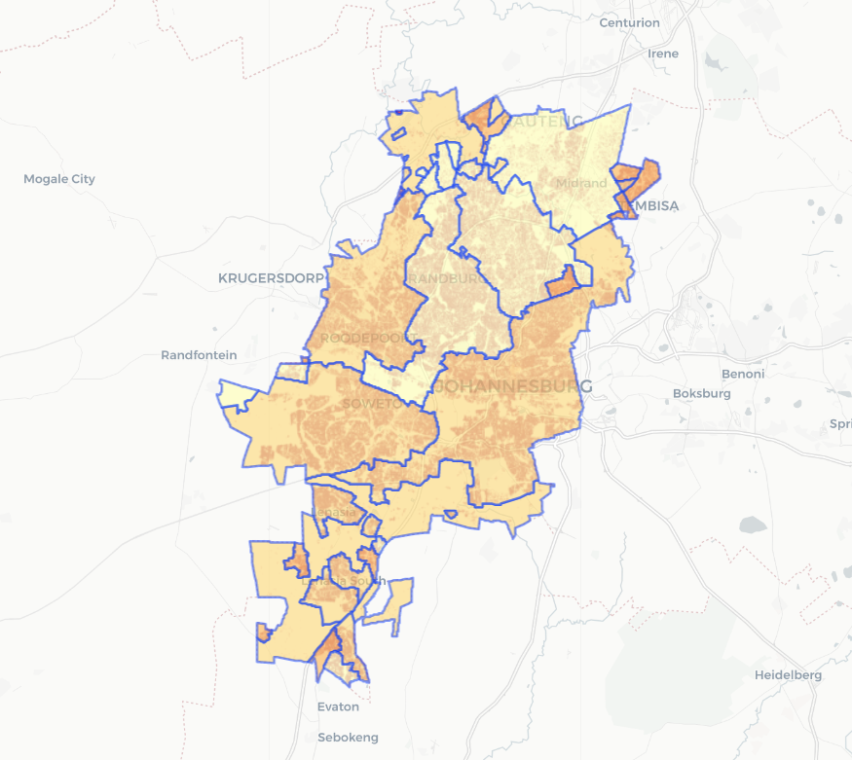
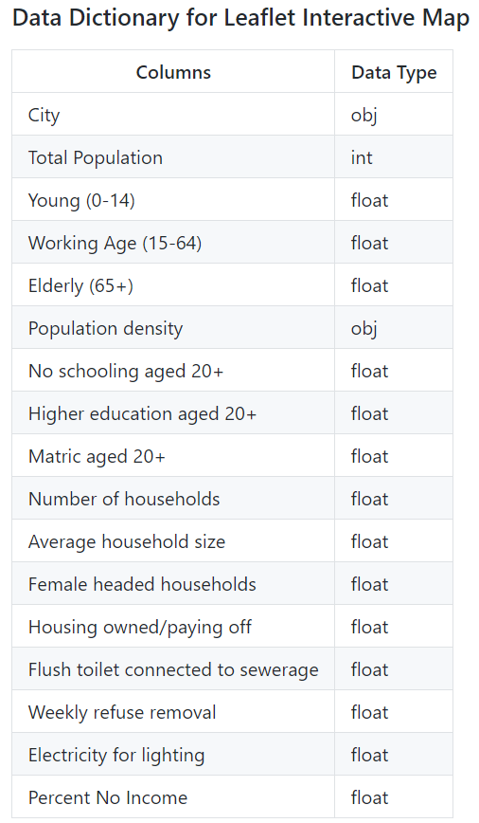
2011 Census Acquired Data

Slide 6
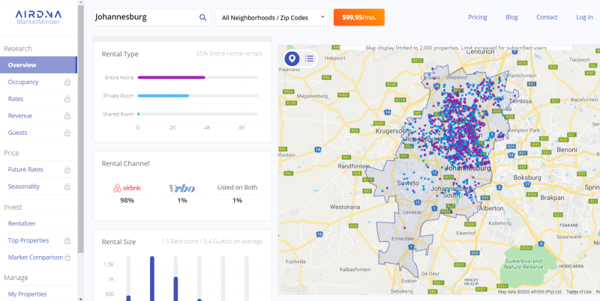
Attempts at Collecting Real Estate Data For Johannesburg

Slide 7
Why use open-source data?
Censuses occur infrequently and often using inconsistent methodology
Records data at a low resolution with discrete distributions so we assume constant distribution throughout the census-designated administrative zones.
By definition slums are underserved by government resources and making it harder to accurately gauge the population
Also important for slum identification: censuses not account for rapidly shifting populations (economic migrants, refugees etc.)

Slide 8
Facebook’s DataForGood in South Africa
Partnership with the Center for International Earth Science Information Network (CIESIN) at Columbia University
Uses neural networks to train pattern recognition algorithms on overheard satellite imagery and then combined with with datasets from the census, USAID, and the World Bank
Advantages over the census:
Updated annually
Claims to report population distribution at a 30 meter resolution
https://dataforgood.fb.com/docs/methodology-high-resolution-population-density-maps-demographic-estimates/

Slide 9
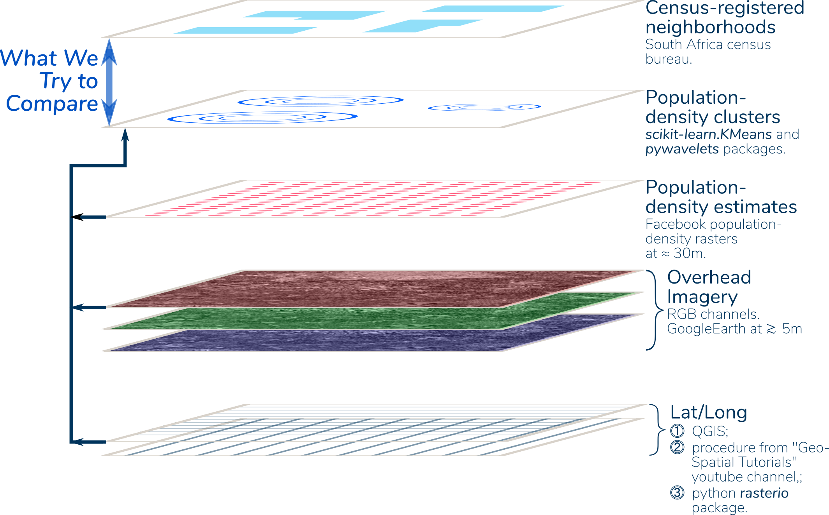
Technical Approach
Information Sources:
⓵ An underlying geopsatial reference frame;
⓶ "Official" population-distribution information; and
⓷ "Alternative" population-distribution information.

Slide 10
Since Google Earth’s imagery is not geo-referenced, we added a limited number of geo-referenced labels (right) then used QGIS to attribute (𝘓, λ) associations to our labels.
Final product: GeoTiff image with an estimated pixel resolution in the range of five to ten meters.

Slide 11
Blue box: windowing, < 65,000 measurements
Red pixels: estimates in regions on interest, > 94,000 measurements

Slide 12
Modeling the Data
An unsupervised learning approach gives insight into the features that discriminate between the two as we seek to compare population clusters in our “ambient” data against “official” measurements
Explanatory variables:
Features from our Facebook population-density estimates including both geographic (𝘓, λ) and the actual population estimates;
Features extracted from our overhead imagery to introduce spatial cohesion
Possibly future extension to binary classification.

Slide 13
Modeling the Data: Imagery Feature Extraction
Discrete Waveform Transformation: recursively partitions a data set a specified number of times. This partition is accomplished using filters, which orthogonalize the data at each stage resulting in a set of features that are uncorrelated.
The distinct Facebook population-density estimates at 30-meter resolution provide our principal explanatory variables. These contain geographic (𝘓, λ) and point population-density estimates. We extend these with imagery-feature attributes. First, we compress our three-channel (Red, Blue Green) image into a single-channel gray-scale intensity array. We take a 128×128-pixel window centered on each Facebook population-density estimate.
The model described here is based on three levels. This produced an explanatory-variable matrix comprised of 1,603 features for each of ≲66,000 observations.

Slide 14
K-Means Clustering
Explanatory variables included the Facebook population-density estimates, the corresponding geographic (𝘓, λ) for each, and all of the coefficients from a three-level DWT of a 128×128-pixel window centered on each.
Models were fit for variations on these characteristics, including DWT window size and DWT levels. Models were considered with the data scaled and non-scaled. Non-scaled data produced more-localized results, owing to the affects of strong (𝘓, λ).
Although we attempted Principal Component Analysis to reduce the number of features, it afforded no reduction in dimensionality.

Slide 15
Kernal Density Estimate
The cluster distributions are nonconvex and widely distributed, particularly expansive in the vertical dimension with multiple peaks. This means lots of cluster members are going to be widely separated, with dilutes silhouette scores.
More-localized clusters in the vicinity of our know "slum", Alexandra, Gauteng. This is the bright area bounded by about 28.08 and 28.1 𝘓 and -26.13 and 26.11 λ. Our imagery features appear to discriminate slum from non-slum areas.
non-slum contours appear to be concentrated between about 28.02 and 28.07 𝘓. This seems to be the heart of the Johannesburg populated area. It seems that the Population attribute is dominant in this region.

Slide 16
Evaluation: Model Contours with Overhead Administrative District Boundaries

Slide 17
Conclusions and Recommendations
The lack of real estate data makes it more difficult to identify slum areas but using satellite data to locate clusters of upmapped populations in conjunction with official census and open source data is promising.
Recommendations for Improvement:
”Professional grade” satellite imagery vs. Google Earth
Harnessing cell phone geolocation to improve identifications of slum areas not thoroughly represented in the census.
More-sophisticated machine-learning algorithm.

